Slide 1
Alternative Scientific Truth: Damage Behind Vaccination Myth in Lithuania

Slide 2
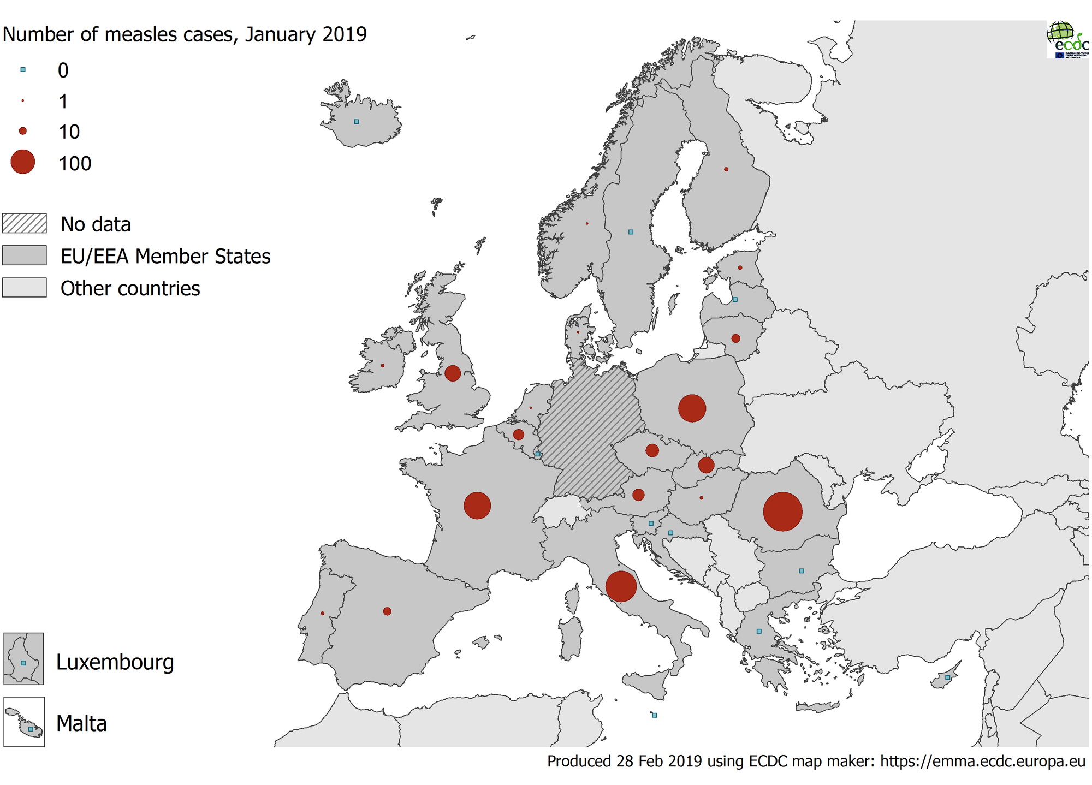

Slide 3
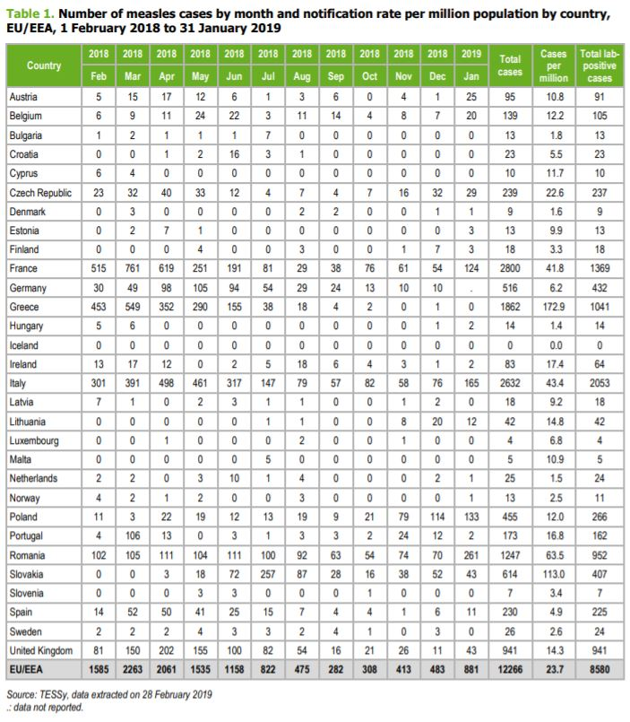

Slide 5
Member of Lithuanian Parliament D. Kepenis claim about vaccines:

Slide 6
Who is Dainius Kepenis?
In 2016 Dainius Kepenis have took a seat in Lithuanian parliament.
D. Kepenis is also a president of Lithuanian NGO ‘Lietuvos sveikuolių sąjunga’ that promotes healthy lifestyle, ecology and alternative medicine.
In Lithuanian Sport University D. Kepenis have finished Physical Education course and after his studies pursued Physical Education Teacher career in Lithuanian school.
D. Kepenis have never gained medical education and has no formal or practical knowledge in complicated medical issues.

Slide 7
How myth was created?
Repetitive messages by Lithuanian propaganda spreading websites: ‘Doctor of Sciences Jessica Farnsworth: vaccine creation from aborted babies’; ‘What do you need to know about vaccines and danger of vaccination?’
Biased study conducted by American Christian family physician J. Farnsworth
Expressive and persuasive claim made by the Member of Lithuanian Parliament D. Kepenis.

Slide 8
The Real Scientific Truth:
Some vaccines are made using human or animal derived cell material;
There is no alternative way of creating effective vaccines;
Two cell lines that are now being used for creation of vaccines were created in 1960s. These cell lines are now growing on their own in vitro;
There is no need to create new cell lines;
Nevertheless historic usage of aborted children cells raises moral doubts, Catholic Church approves of vaccination. Evil once created dissolves when is being used for public good;
Scientific truth mixed with false information and biased claims creates chaos and might damage society.

