Slide 1
Media Literacy and Critical Thinking

Slide 2
What is Media Literacy?
Memorizing facts and statistics about the media
Bashing the media
Protecting kids from unwanted messages
Raising the right questions about what you are watching, reading and listening to
The ability to think for oneself
Being aware that we can not escape today’s media culture

Slide 3
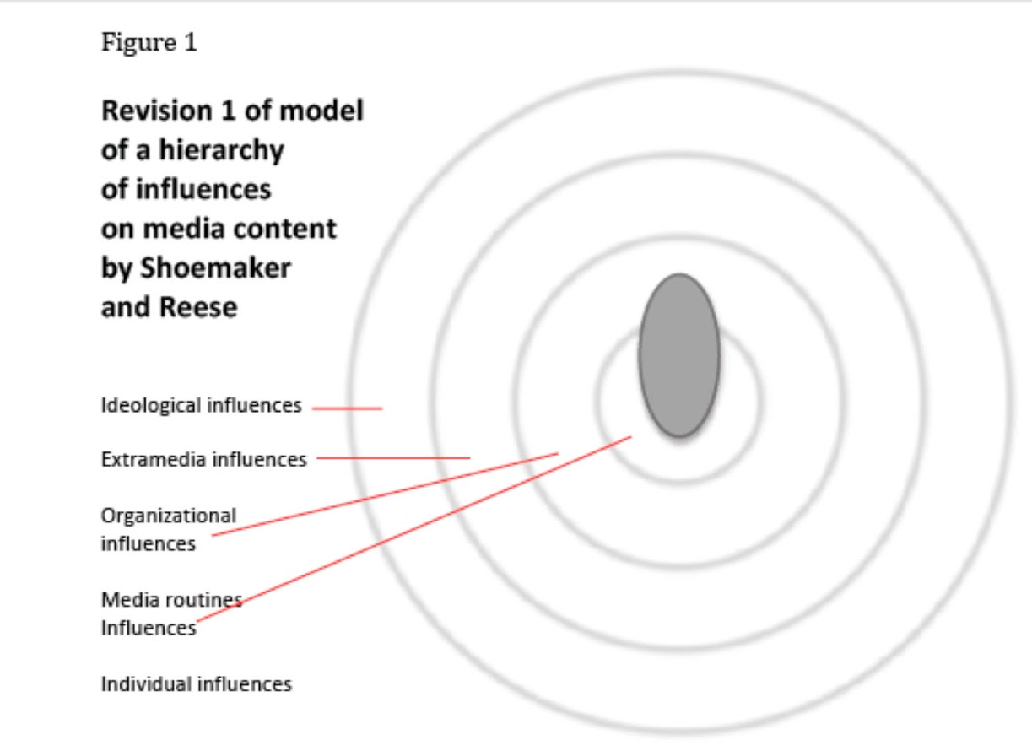
Construction of Media
Media do not present simple reflections of external reality
Media present carefully crafted constructions that reflect many decisions and results from many determining factors

Slide 4
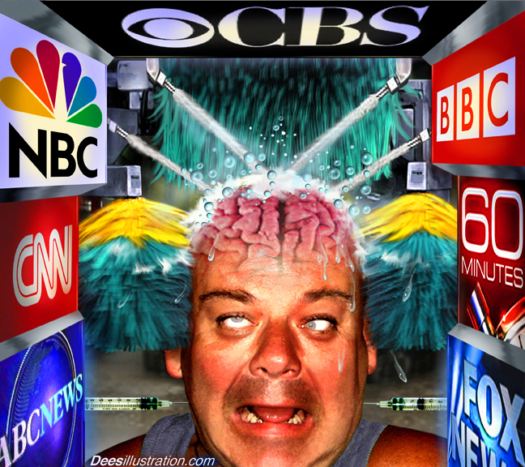
Media construct our perception of reality
Much of our view of reality is based on media messages that have been pre-constructed and have attitudes, interpretations and conclusions already build in.

Slide 5
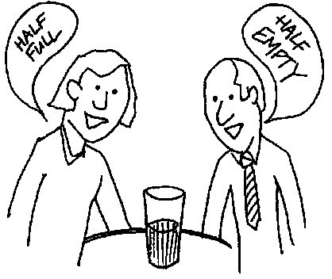
Different impact on different people.

Slide 6
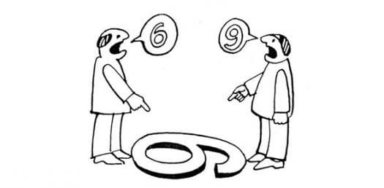
Main Factors
Social factors(Geography, Educational resources, Public health support)
Family factors(Education, Culture, Sport, Income)
Collective health(Child, Parents, Other caregivers)

Slide 7
Commercial implications
Most media production is a business, and must therefore make a profit.

Slide 8
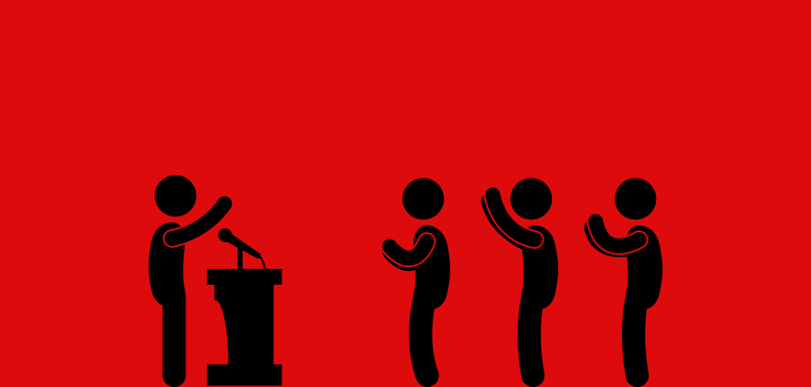
Media have social and political implications
The media have a great influence on politics and on forming social change.
Ex: Television can greatly influence the election of a national leader on the basis of image.

Slide 9
Media contain ideological and value messages
All media products are advertising, in some sense, in that they proclaim values and ways of life.

Slide 10
Critical Thinking Process

Slide 11
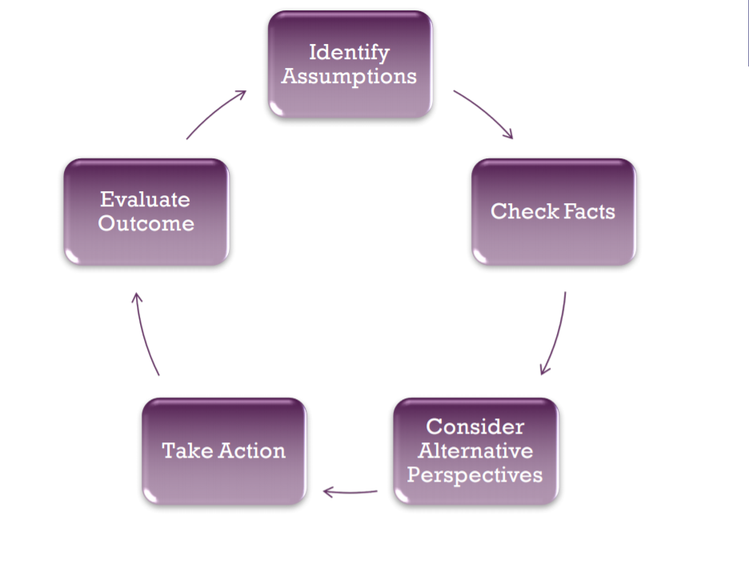

Slide 12
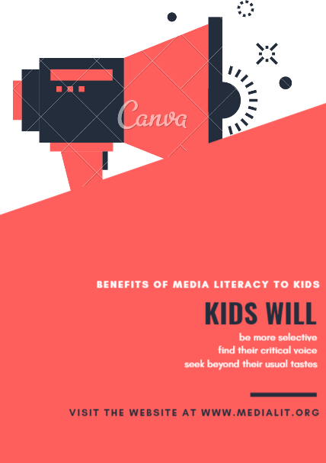
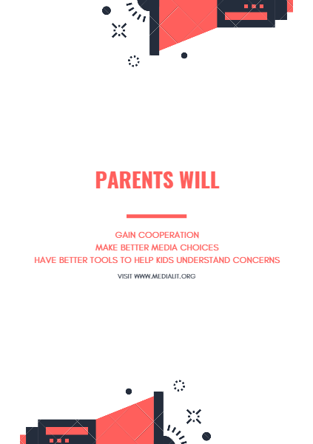

Slide 13
Thank you for your attention !

